Slide 1
Can your enterprise harness cloud for agility, efficiency and innovation?
Enterprise Cloud Computing
Justine Harris
April 2011
Notes:
Thanks for your time today. In the next 30 minutes or so I’d like to share CA’s point of view and approach to harnessing cloud computing for agility, efficiency and innovation.

Slide 2
Enterprise IT needs a game-changer
Consumerization of IT
Business Demand for IT Services
Demand for shorter cycle times
Unsustainable
Recession
New Normal
IT Budget
IT Service Supply
Complexity Slows Productivity
(60-80% of budget spent keeping lights on)
2003 - 2008
2008 - 2009
Notes:
A theme we keep hearing from many of our customers is that they want to use cloud computing as a real game changer.
We believe this is because IT has found itself in a perfect storm over the past couple years.
The first storm is not new, but it’s a big one, and that’s complexity.
the layers and layers of complexity in IT make it slow and expensive to change or add new business services.
We used to throw more people at money at the problem but thanks to the GFC that’s no longer possible as IT budgets are now flat….
And of course whilst the GFC has slowed IT down, it hasn’t changed the business demand – the business wants us to do more, and do it faster!
And so IT's stuck in between these two opposing forces with an unsustainable gap between business demand for IT and IT's ability to supply
So this is why we believe incremental improvements are not enough, and why people are looking to cloud to change the game.

Slide 3
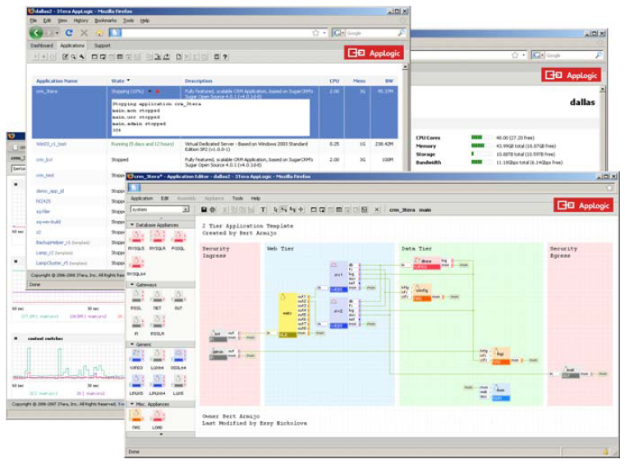
Global Media Giant: Challenge
Do more with Less
Skyrocketing internal demand (+30%) for the deployment of specialized web functionality
Provision of content across multiple platforms
Requirements:
Rapid deployment for standard dev stacks
Shorter time-to-market for new web sites
Best in class IT infrastructure
Notes:
The problem here is not unique and I’m sure you can all relate......
This company came to CA because they have 3 key focus areas in their business – movie releases, sports websites, games sites...
Two of their webistes had crashed within the month because they couldn’t forecast the popularity and unfortunately both ended up being BLOCKBUSTER movies...... They were losing MILLIONS per day – because they hadn’t provisioned for the demand and their websites crashed......
Do more with less
Cut costs, no additional head count - reduction in budget, scalable IT
Increase internal demand from the business
Does that sound familiar?
This is nothing 3Tera Applogic can’t handle!

Slide 4
Cloud elevates IT to focus on innovation
66%
Two-thirds of 655 Gartner Data Center Conference attendees in a keynote session responded to a poll asking, “Will your enterprise be pursuing a private cloud computing strategy by 2014?”*
Business Demand for IT
Private Cloud
Collapse cycle times
Industrialize
data centers
for agility, efficiency
IT Supply
Public Cloud
35-50% “CIOs see the introduction of Internet service-based technologies as changing that equation and releasing between 35 to 50 percent of infrastructure and operational resources for innovation and growth.”**
Offload commodity services to trusted clouds
“Innovation dividend”
*Source: Gartner, Inc. “Private Cloud Computing Ramps Up in 2011”, Thomas Bittman and Donna Scott, March 3, 2011
**Source: Gartner Press Release, Gartner Executive Programs Worldwide Survey of More Than 2,000 CIOs Identifies Cloud Computing as Top Technology Priority for CIOs in 2011, January 21, 2011.
Notes:
Cloud can change the game for IT in two key ways
Private cloud is about applying the formula of cloud computing to enterprise data centers to improve agility and efficient use of assets.
We're seeing a fast adoption rate of private cloud, and in fact a survey at Gartner’s Data Center Conference found that 66 percent of companies are going to be pursuing a private cloud strategy over the next few years.
That really matches up with what we see across our customer base.
Customer are using the cloud momentum to drive the changes they’ve always wanted to but hadn’t had the mandate to do so….. And that’s to industrialize, standardize, automate and measure…..
<BUILD>
The second way cloud changes the game, is to let IT offload more of the commodity services to public clouds – and focus more on what’s unique to its business.
CIOs themselves who say moving to public cloud can free up between 35 and 50 percent of operational and infrastructural resources.
That’s a strategy we see being very effective –
using cloud initiatives to rationalize the infrastructure, freeing up both capital and people to fund innovation.
What is ultimately key for the IT departments is working with the business to collapse the cycle time that it takes to get a business idea into a production service.

Slide 5
IT will be accountable for management and security across a diverse range of cloud and traditional models
The New Heterogeneity
New Questions
Private
cloud
Use IaaS
Which applications do we move to which cloud models when?
How do we minimize security, compliance and availability risks?
How do we avoid vendor lock-in?
Which operational processes do we keep, tweak or transform?
How do we make sure it is all working together for business value?
New datacenter
Virtualization
Converged
infrastructure
Use
SaaS
Cloudburst
Fabric
Existing datacenter
Build on PaaS
Hybrid
Cloud
Traditional services
CA solutions provide you with visibility and control to decide on, migrate between, and manage across cloud and traditional service models from a business service value perspective.
Notes:
Of course we all know that it isn’t as simple as just private and public cloud.
As a large enterprise your diverse business needs will take you down many of these paths at the same time. And whether it’s the business or IT that is leading each choice, we all know where the accountability will lie for making sure it all works together: the IT organization – FACT
So at CA, this new landscape is what we’re calling - The New Heterogeneity.
<BUILD>
Which means IT needs to be sure to ask the right questions, such as,
which applications do we move to which cloud models, and how do we prioritize that?
Or how do we manage security and availability risks so we can take greater advantage of public clouds?
Vendor lock in is very important…..you want to make sure you can leave whenever you need to without leaving behind the IP investment you might of made……
And ultimately the most important question is, is it coming together to solve a business need and is all of this working together for the benefit of the business?
Being able to answer these questions means having a broad view of cloud. You need to ensure your existing management disciplines do not go away, but they must be adapted, extended and optimized for this new heterogeneity.
<BUILD>
This is what CA does better than any other company on the planet -- manage complex, heterogeneous environments from a business service perspective.

Slide 6
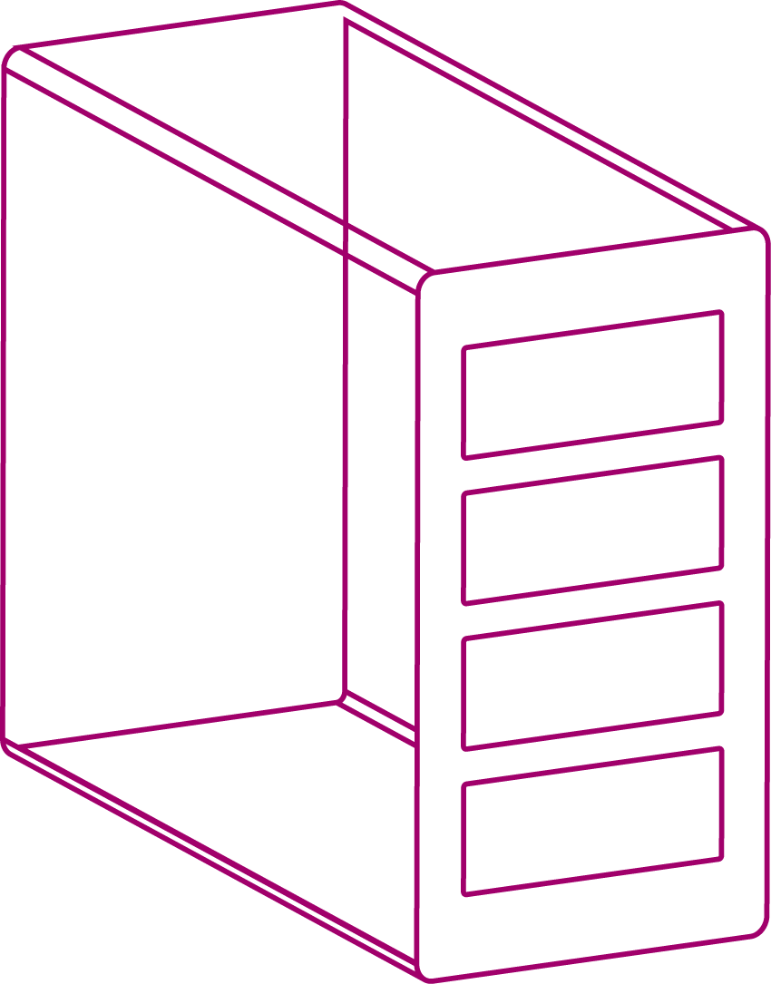
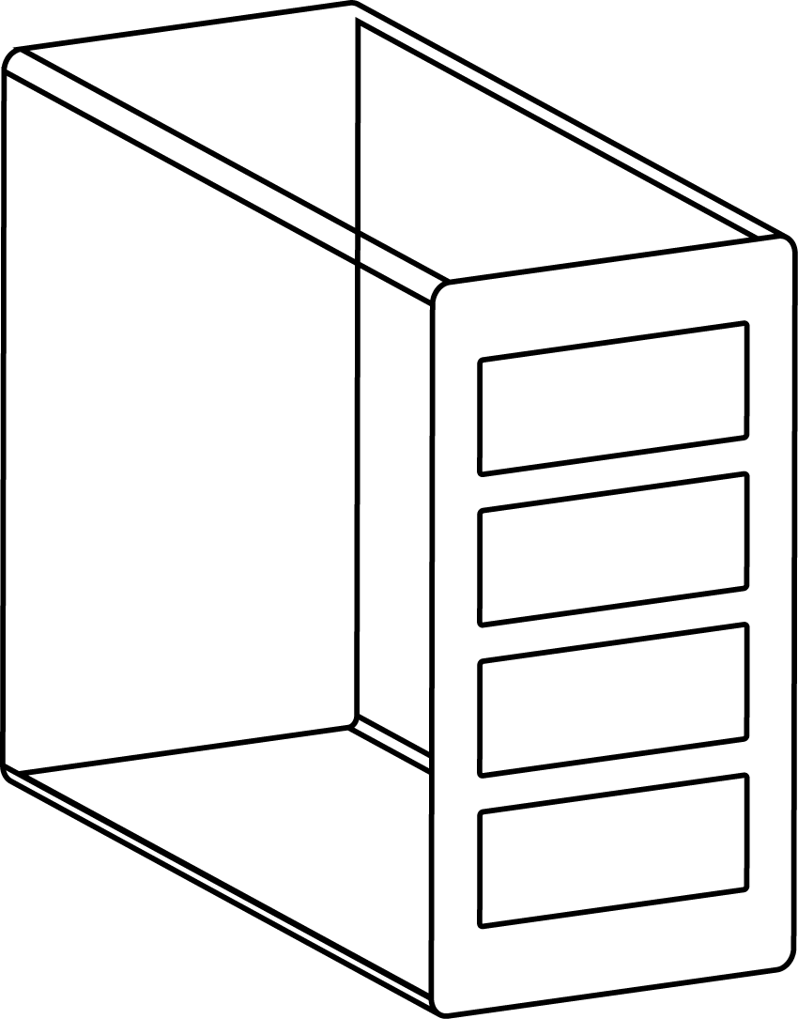
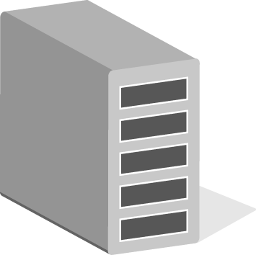
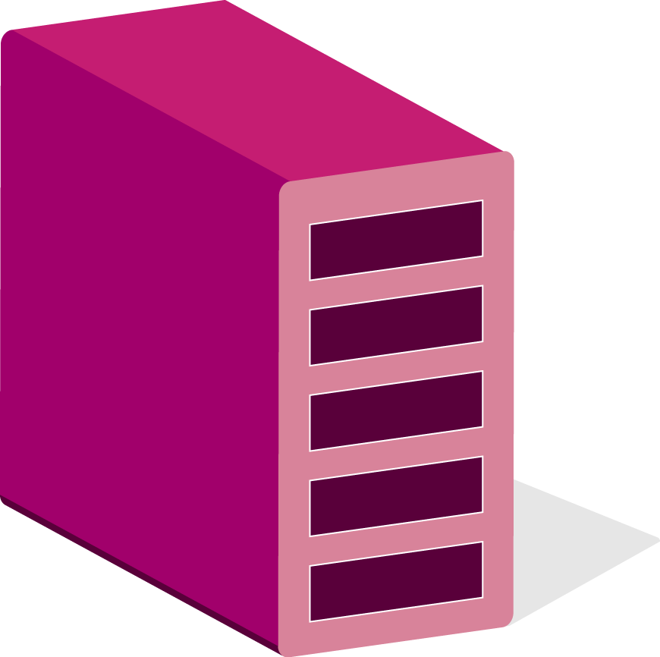
CA helps you USE and PROVIDE cloud and traditional services and TRANSFORM for agility, efficiency and innovation
Use public cloud with greater confidence
Secure, monitor, and incorporate public cloud services into your management processes
Provide agile private/hybrid cloud services
Extend virtualization with application-centric self-service automation, security and management
Cloud Services
Brokered
Cloud Services
Virtual Assets
Private/Hybrid
Cloud Services
Service User
Physical Assets
IT
Traditional Services
The Business
Transform development-to-production cycle times for business innovation
Align service development, test and production environments and processes
Notes:
<BUILD>
Broadly speaking CA is focused on helping enterprises realize three key outcomes to harness value from cloud computing.
<BUILD>
The first outcome is for you to use public clouds with confidence so you can off-load commoditized services onto public clouds.
This includes IT consuming IAAS for hybrid clouds and cloud bursting,
IT as a broker to make all kinds of cloud services safer for responsible business consumption and CA can extend your security, monitoring and your management processes to public clouds.
So it enables you to manage the clouds, as you would the rest of your enterprise services that your business has come to depend on.
<BUILD>
The second outcome is for you to provide both cloud offerings – so whether you want to build a cloud model with your existing datacenter, or with a new datacenter, CA can extend those investments in hardware and hypervisors with an application-centric approach to self-service automation, security and management so you can populate your private or hybrid cloud with the applications and services your business depends on.
<BUILD>
The final outcome is to transform the development to production cycle for accelerated innovation. We see this as the really exciting outcome made possible by a move toward cloud. So ultimately you get ideas turned into production services faster.
So our enterprise cloud strategy is focused on three key outcomes for our customers:
using cloud services,
providing clouds services
and transforming their development-to-production cycles.
Now let’s take a brief look at HOW we do that.

Slide 7
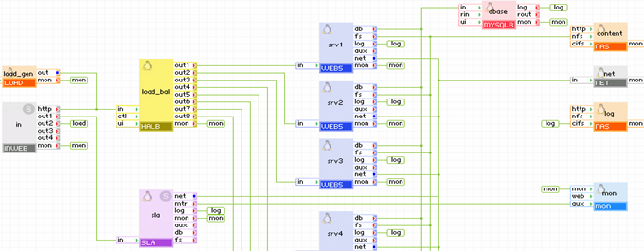
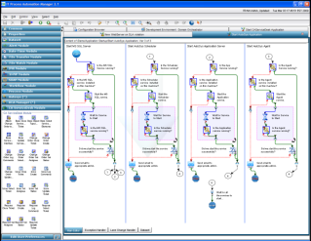
TRANSFORM service dev-to-production cycles for business innovation
“It’s our dev environment, available on demand.”
“It’s our test environment, problems are easy to recreate.”
“It’s our production environment, self-scaling and portable.”
Business
QA
Operations
Virtual Fabric
Pooled virtual network, storage, compute on x86
Drag-and-drop service design
Unified design, test production environment
Automation
Codify interactions between resources, people
Drag-and-drop workflow design
Unified process orchestration
Private Cloud
Common Environment
and Processes
Virtual Business Services
Notes:
By transformation, we're primarily talking about the development to production cycle for new business service offerings.
Here’s the problem we’re out to solve. 95% of all new application deployments run into trouble and delays.
The problem isn’t usually the application code itself but how it works in different environments. You have one environment for the developers, the QA team might have one slightly or a lot different and then it’s final production environment introduces yet more differences and many more dependencies.
In each case it’s difficult for each team to duplicate the errors found in the other team’s environments, leading to more delays.
We address this by providing a common environment and processes.
<BUILD> CA has a clear lead thanks to its 3Tera acquisition and it’s virtual fabric technology.
It takes compute resources like bare metal X86 boxes on a high-speed network and turns them into a single resource pool of processing, memory, storage and networking. It also runs things like virtual load balancers and SANs as just another piece of software, so the entire service – the application and its infrastructure – can be virtualized and kept intact as it moves through your service production line.
In the enterprise you may not have seen this before now and that’s because our solution was primarily designed for the cloud service providers because they embraced & standardized on open source hypervisors…. So as of June this year we support VMWare hypervisor, so enterprises are truly gaining access to the technology that managed service providers have been using to become cloud services providers for the last 5 years.
<BUILD> Virtual fabric is one approach to deployment that can co-exist with automation. We can automate provisioning across your heterogeneous environment as well, so you can join your existing data center and your virtual fabric together with one umbrella of management. And a key to the whole private cloud environment is process automation which allows you to orchestrate how people and systems work together in a more agile way.

Slide 8
Virtual Business Services Unlock Data Centers To Focus on What Matters Most – the Application!
Increasing Efficiency and Agility
Virtual Server
Virtual Business Service
Web
App
DB
App
Web Server
Database
Server
OS
OS
OS
OS
OS
OS
Virtual Hardware/
Resources
Load Balancer
Router
Monitoring
Metering
App
OS
Memory
CPU
VLan
SAN
Virtualized
SAN
Load Balancers
Security
Virtual Service Fabric
Switch, Storage, Network, CPU, Memory
Network
Hypervisor
Hypervisor
Hypervisor 1
Hypervisor 2
Phys Server
Phys Server
Phys Server
Phys Server
Phys Server
Notes:
Let’s step through the evolution to the virtual world to get a better picture
We started with an app and OS, chained to a physical server. Not too mobile or that dynamic – you’ll agree
<BUILD>
Then along came virtualization. We could now dynamically allocate a virtual machine, mimic a physical machine, and deploy to a server.
This enabled us to do more with less - But, it can only get us so far because …
You‘re still chained to your hardware – in essence, you still have silos of storage, servers etc.
So when an app needs an additional server, for example, you can spin one up quickly, but you have to reprogram the load balancer to recognize it, - Which requires extensive scripting, which works, but tends to be inflexible.
<BUILD>
What about the rest of the application?
An application, usually needs a database, perhaps an app/web server etc. <BUILD>
So how do you handle the interactions between servers?
How do you scale, secure the network, and ensure it works when deployed with no intervention – and quickly, because you need the server now?
<BUILD>
As a matter of fact, 95% of all new application deployments run into trouble – and they do so not because of the application itself, but because of the rest of the dependencies – the VLANs, the SANs, the routers, the firewalls, the load balancers, the database servers…
<BUILD> When we build 3Tera AppLogic, we recognized this problem and we set out to solve it.
We solved this problem by starting with the entire application – the App, the Web Server and the Database server, for example.
Then we create a model that depicts the architecture of the complete application architecture, how much memory, CPU, network and SAN is to be used by each component, and allocates storage volumes to the applications.
We call this a virtual business service – which is deployed with a click of a button and it works every time - taking the 95% failure rate, down closer to 0
The secret sauce here is the fabric – which enables you to create a single, integrated pool of all the resources an applications needs for deployment using 1 tool, on x86 servers, giving you the speed, responsiveness and margin you need to build a range of industry leading cloud services.

Slide 9
Global Media Giant: Benefits
Business – External Websites
Always available
Go to market reduced by 50%
IT Customer –
-Web Development is consistent
-Fewer support problems
-Reduced downtime
3Tera provided –
Reduced cost to the business
Faster time to Market (ROI)
Notes:
They chose CA 3Tera Applogic because
BECAUSE 3Tera enabled...................
On demand auto scalability
Provided their web developers with a consistent development environment
Which resulted in fewer support calls and reduced downtime...
One of the main reasons they chose the solution was because it also helped them attract & employ the leading lights in the industry.....
If we look at a recent article in the news – POLICE.UK website crashed/stopped working recently when they hit 75,000 hits to their website.... Now if I was the service provider of that service – I can only imagine the penalties associated with this..... Now if they had a solution that could scale up and down on demand ie with the number of hits.... Just think about the bonus you could tie to that availability!!

Slide 10
In Summary
CA Cloud
Use, Provide and Transform
CA 3Tera AppLogic
App Centric, Model Driven, One Single Product
The Virtual Fabric for Virtual Business Services
Get your Apps Deployed Fast
Move and Copy Your Apps
Notes:
CA’s approach allows you to use, provide and transform your business to the Cloud –
CA 3Tera Applogic, I haven’t touched on in too much detail, as now I would like to hand over to Steve Hurford from DNS Europe who are one of CA’s cloud partners, who have based their entire Cloud service offerings on this solution and with that said – I’d like to hand over to Steve.

